Slide 1
Data structure
Red-black tree
Marcelo Garay

Slide 2
Properties - Red-black tree
Every node is either red or black.
The root is black.
Every leaf (NIL) is black.
If a node is red, then both its children are black.
For each node, all simple paths from the node to descendant leaves contain the same number of black nodes.

Slide 3
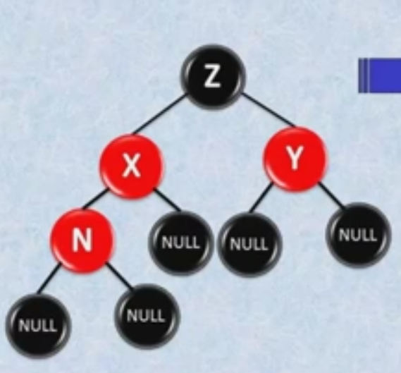
1st rule – dad AND UNCLE ARE “RED”

Slide 4
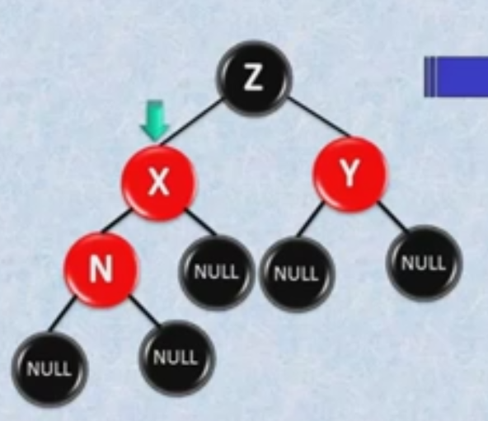
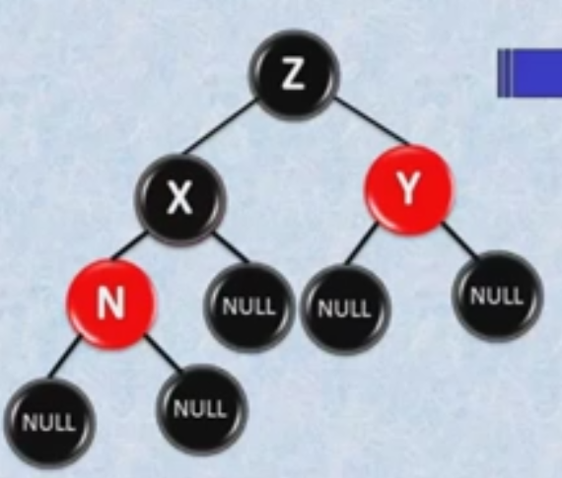
1st rule – dad IS RED

Slide 5
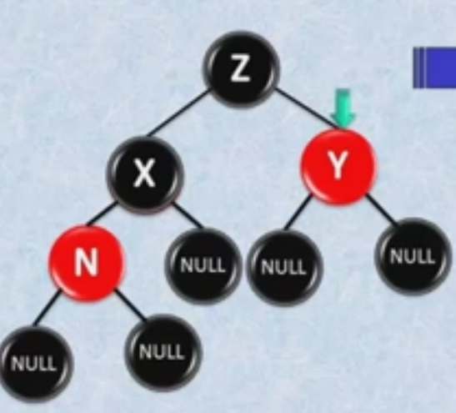
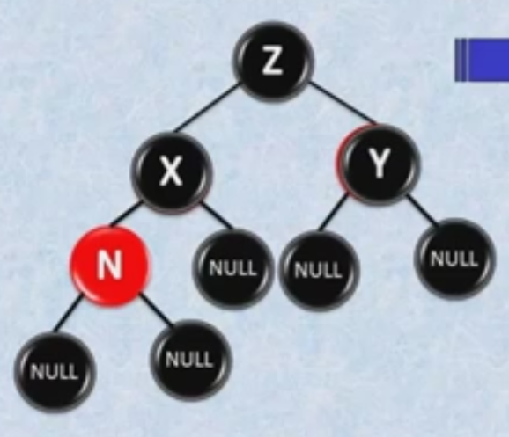
1st rule - UNCLE

Slide 6
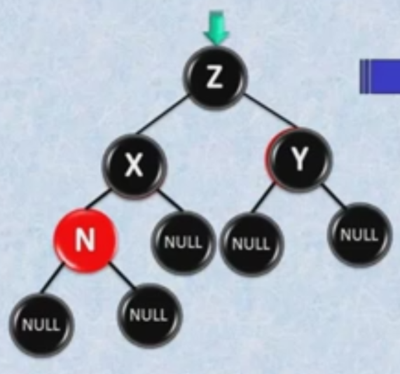
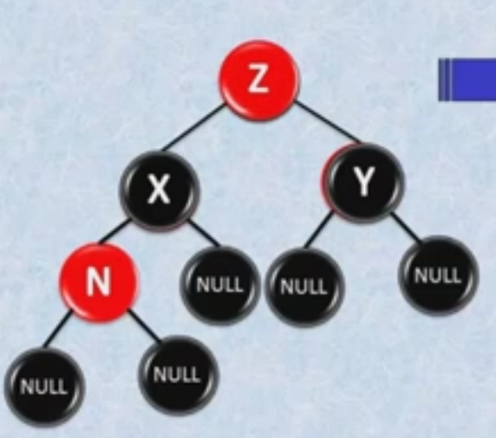
1ST RULE – Grandfather

Slide 7
1ST RULE – Applying 2 property

Slide 8
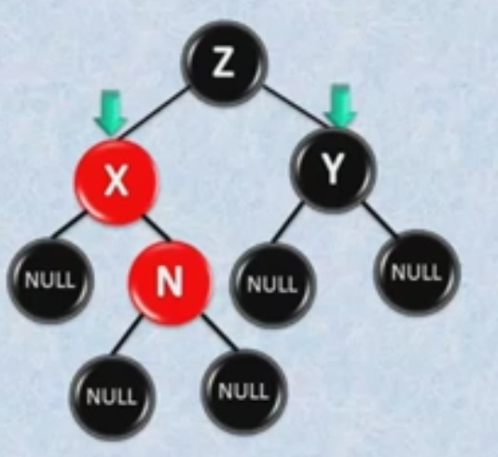
2nd RULE – DAD IS RED AND UNBLE IS BLACK
The node (N) is the right child.
Its father of node (N) is “the left-hand
son of his grandfather”

Slide 9
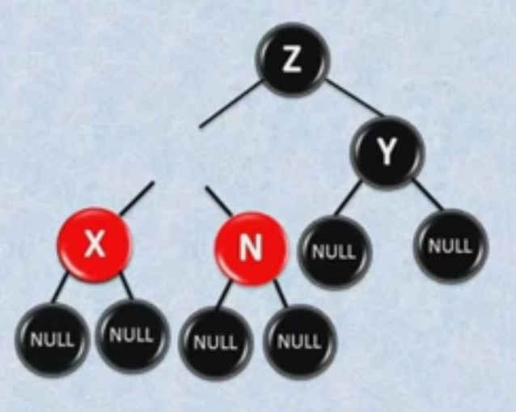
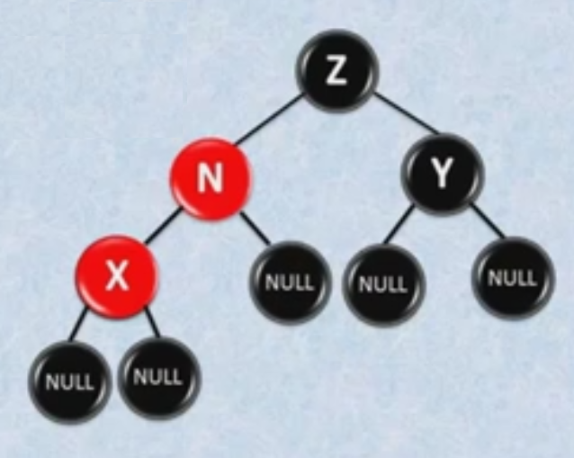
2nd RULE - Rotate through the node (N) to the left.

Slide 10
2nd RULE - Rotate through the node (N) to the left.

Slide 11
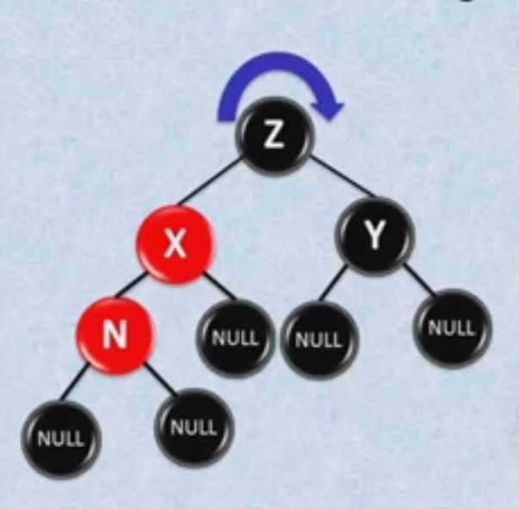
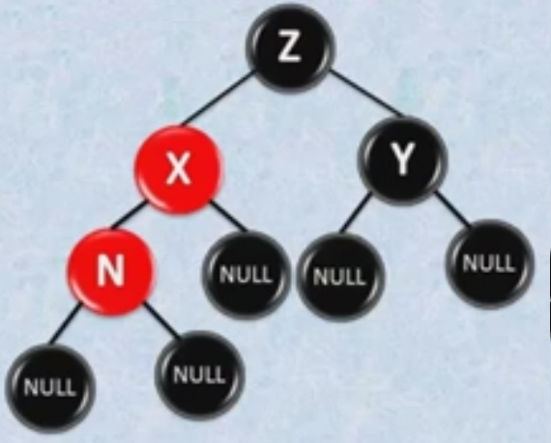
3rd rule – uncle is black and Node (N) is a red father's left child.
Route to the RIGHT by the grandfather

Slide 12
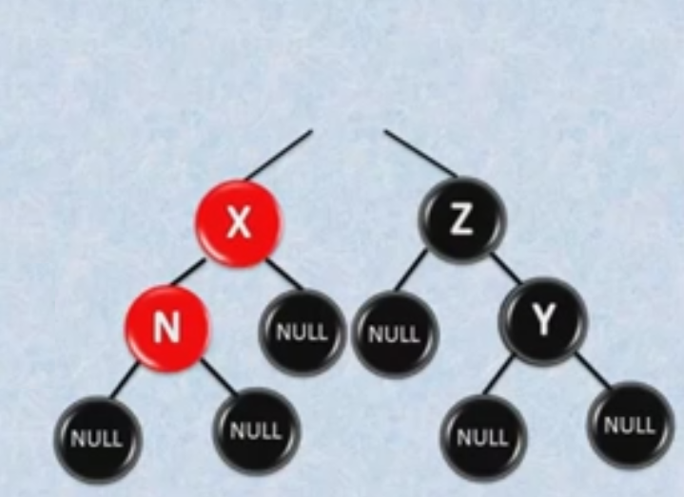
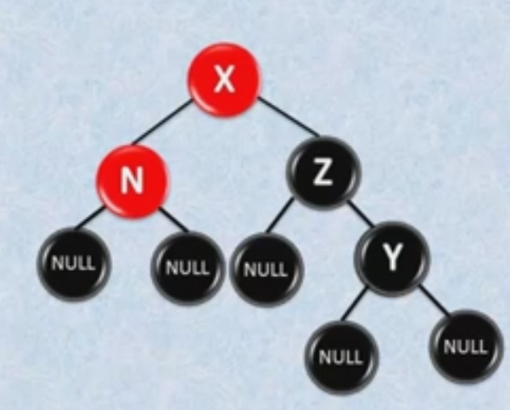
3rd rule – uncle is black and Node (N) is a red father's left child.

Slide 13
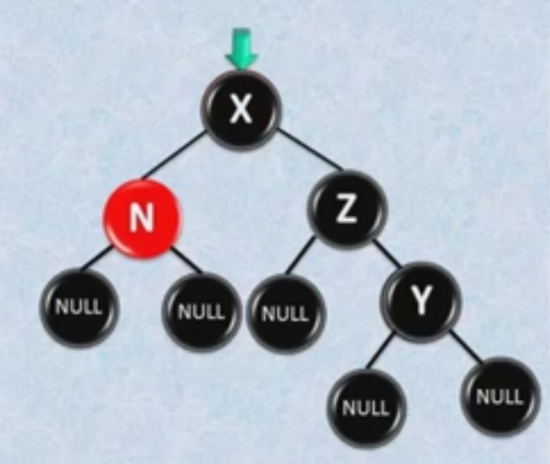
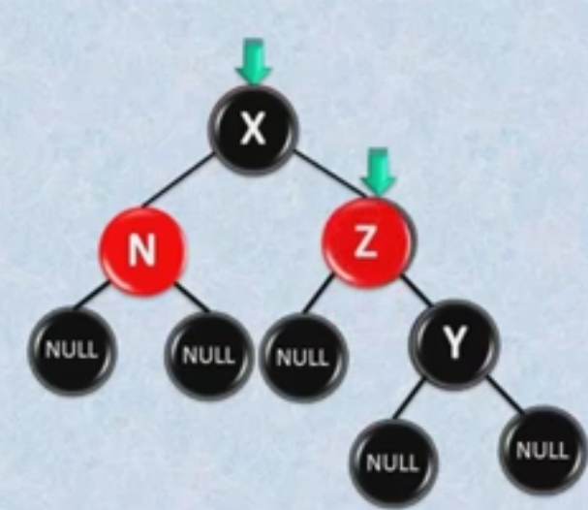
Applying properties

Slide 14
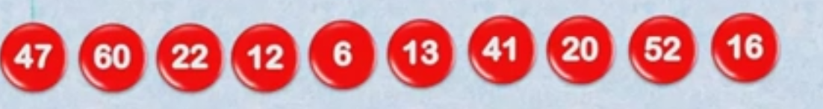
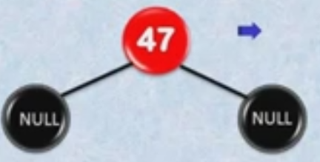
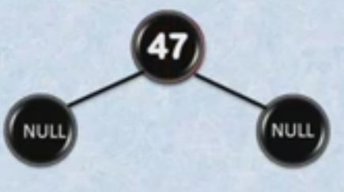
EXERCISE

Slide 15
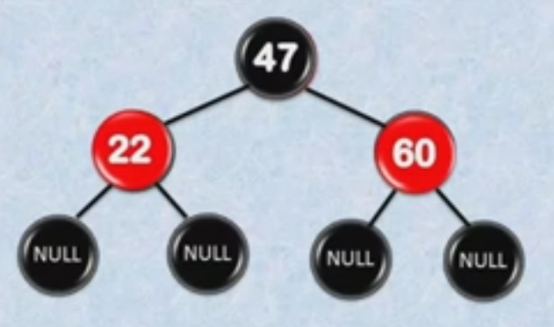
EXERCISE

Slide 16
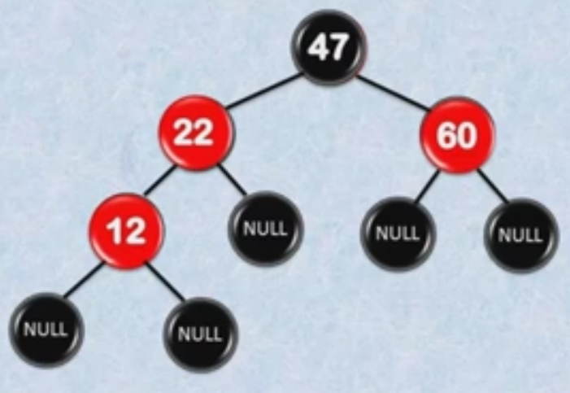
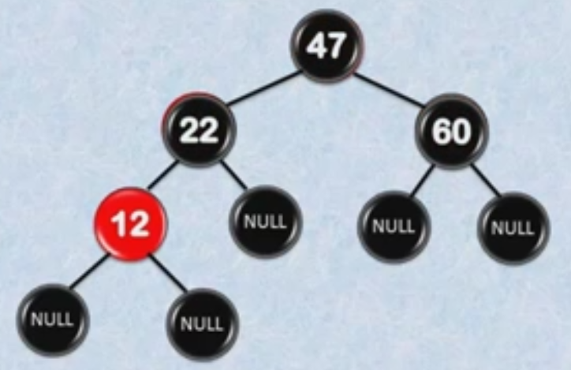
EXERCISE
1st rule

Slide 17
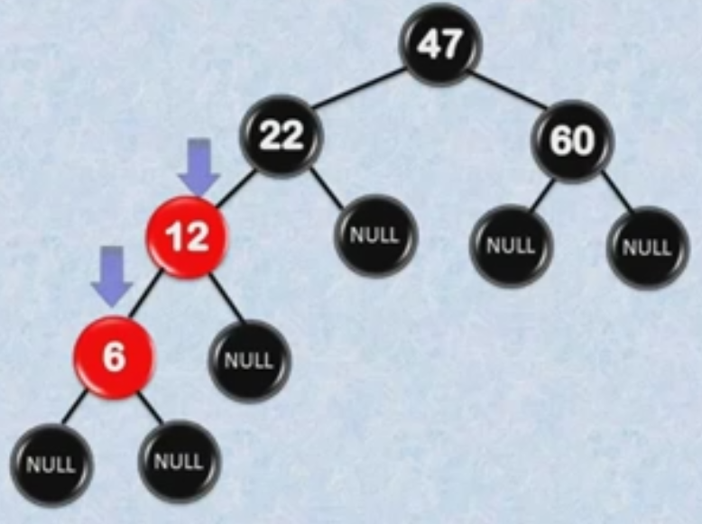
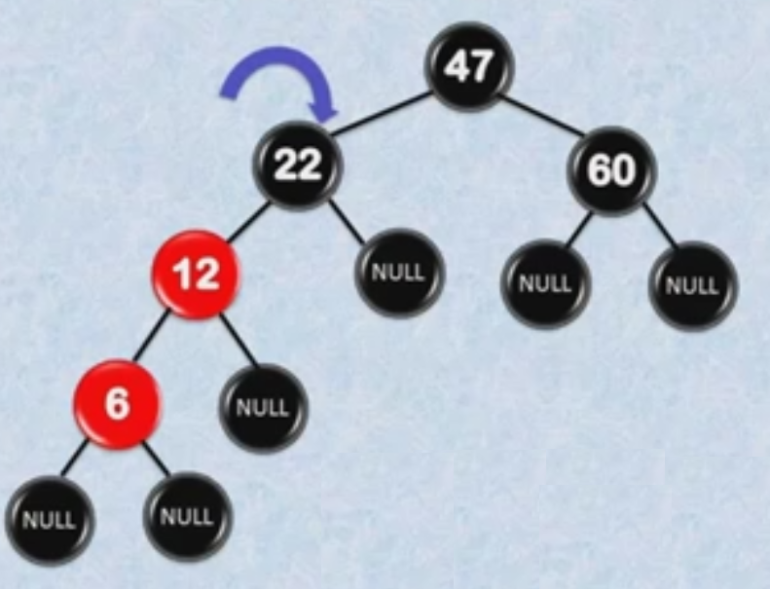
EXERCISE - 6
3rd rule – rotate to right by the grandfather

Slide 18
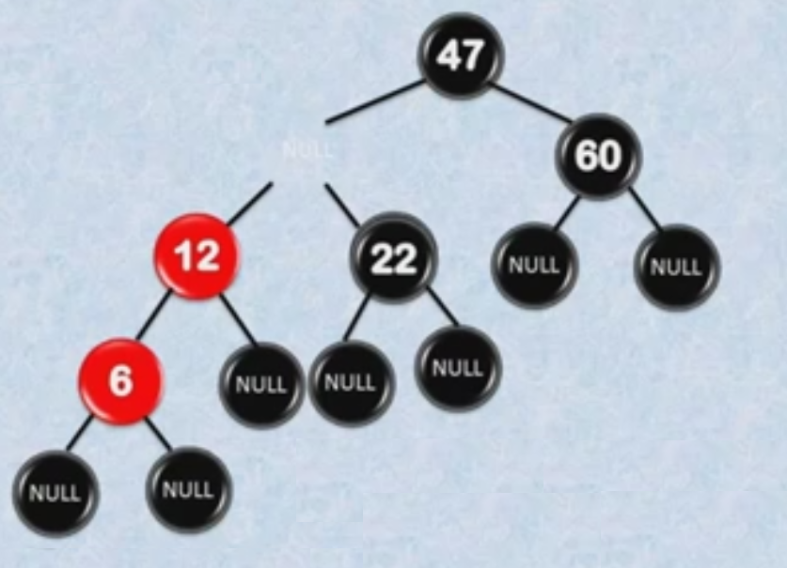
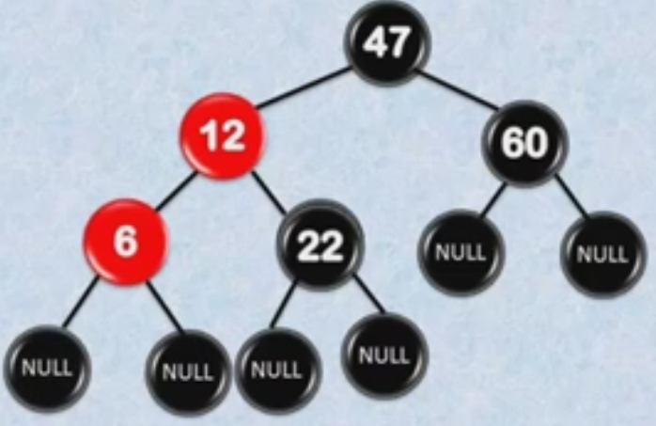
EXERCISE - 6
3rd rule – rotate to right by the grandfather

Slide 19
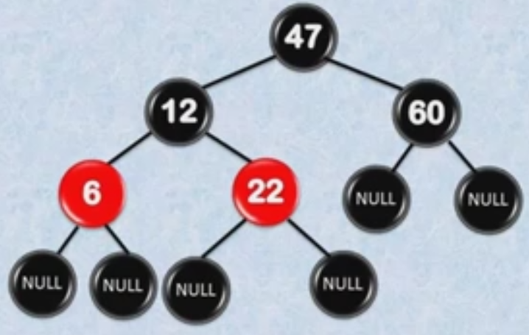
EXERCISE - 6
3rd rule – rotate to right by the grandfather

Slide 20
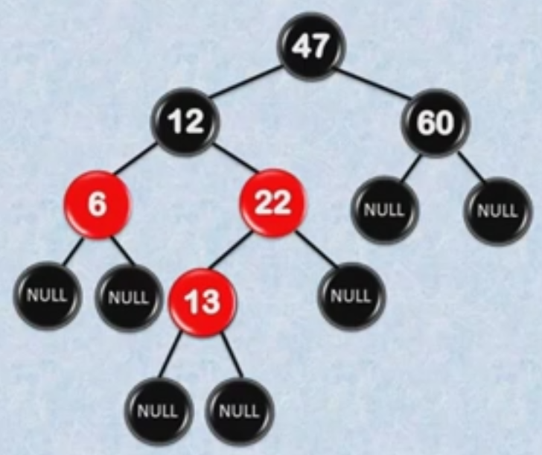
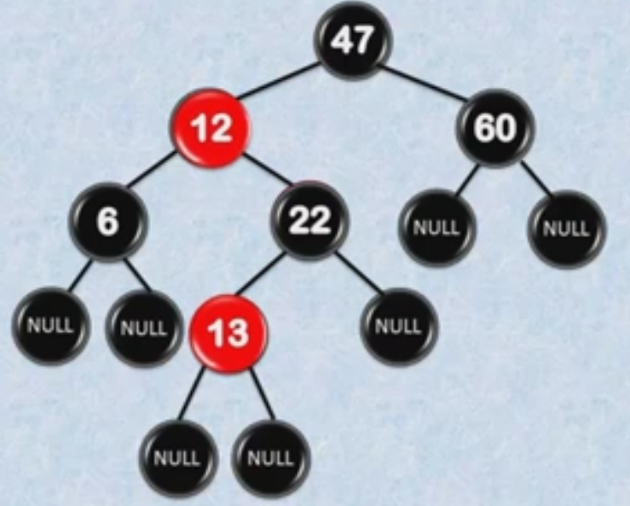
EXERCISE - 13
1st rule

Slide 21
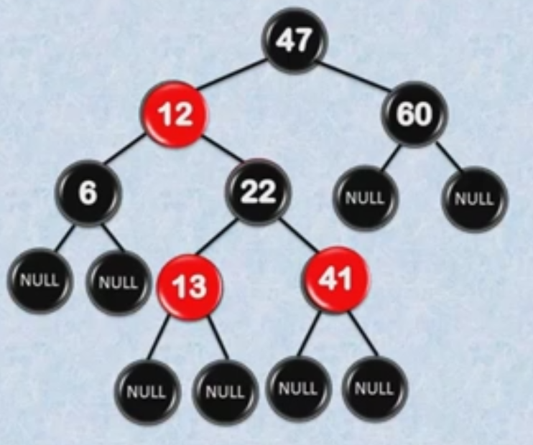
EXERCISE -41

Slide 22
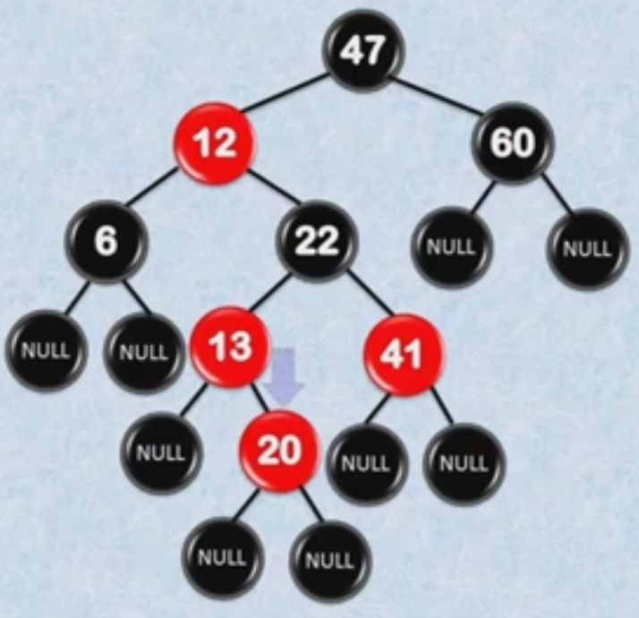
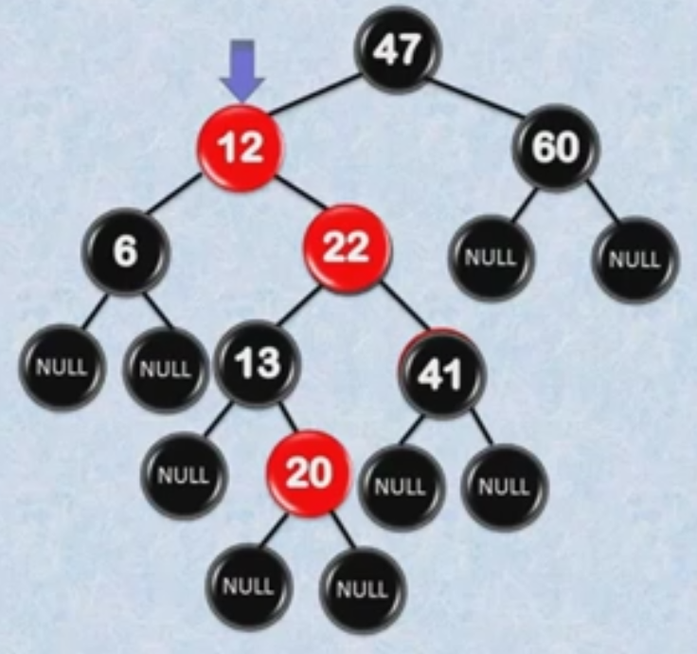
EXERCISE - 20
1st rule
2nd rule rotate to left by father to 3rd rule

Slide 23
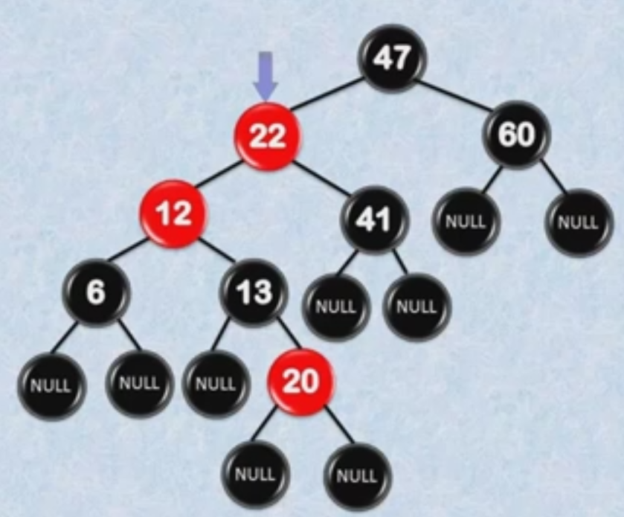
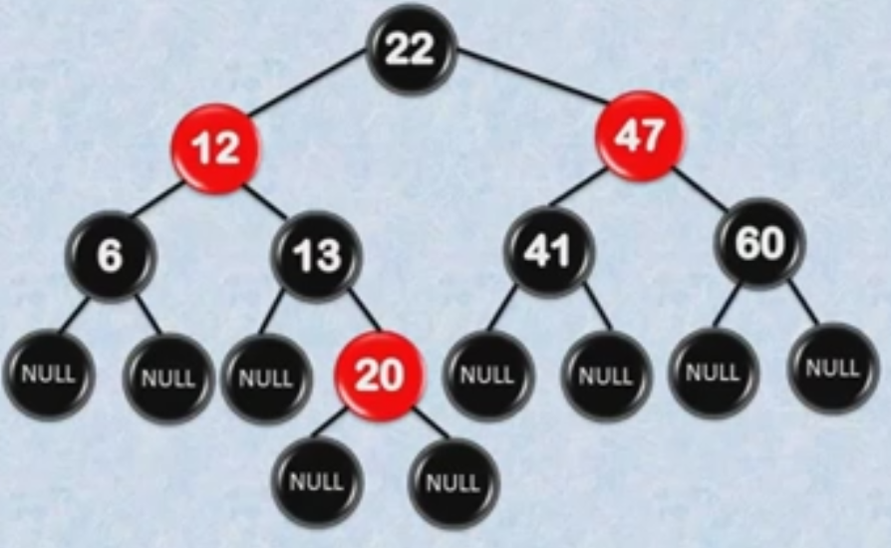
EXERCISE - 20
2nd rule rotate to left by
father to 3rd rule
3rd rule – rotate to right by the grandfather

Slide 24
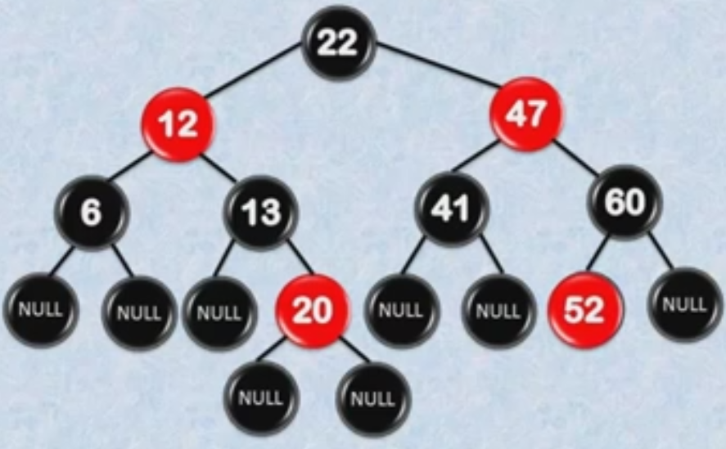
EXERCISE - 52

Slide 25
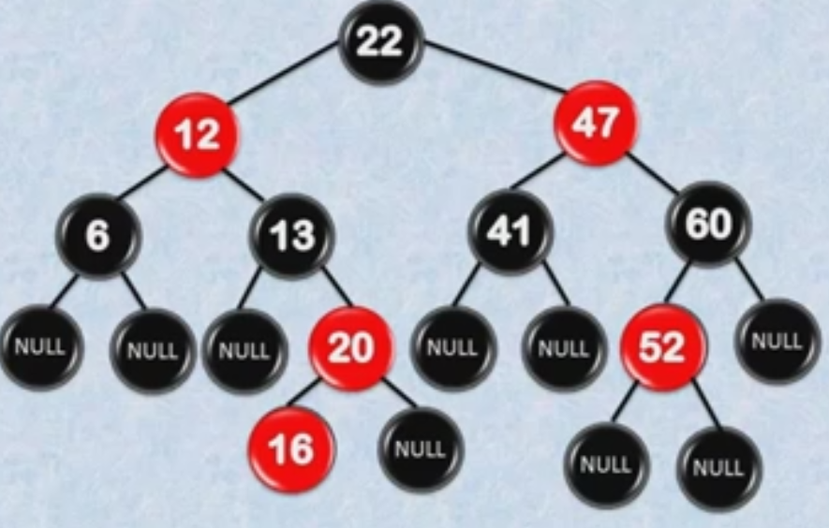
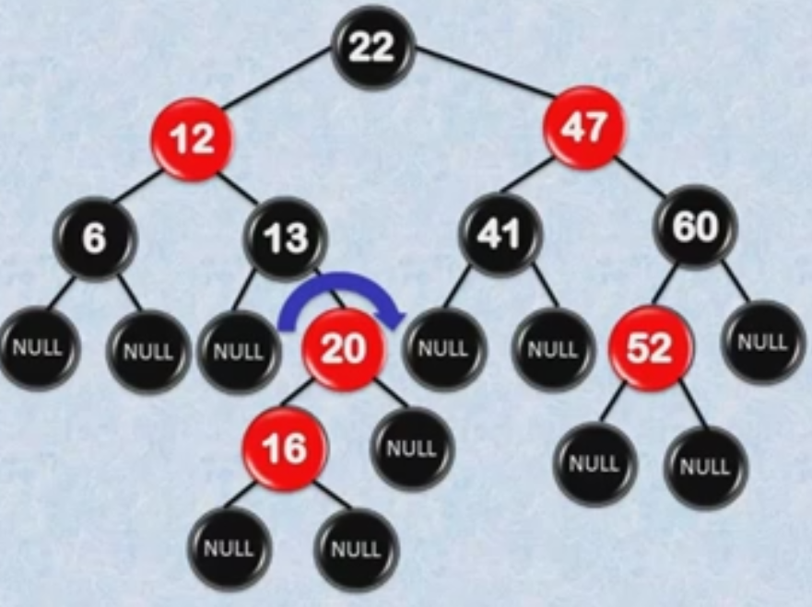
EXERCISE - 16
2nd rule rotate to left by
father to 3rd rule

Slide 26
EXERCISE - 16
2nd rule rotate to left by
father to 3rd rule

Slide 27
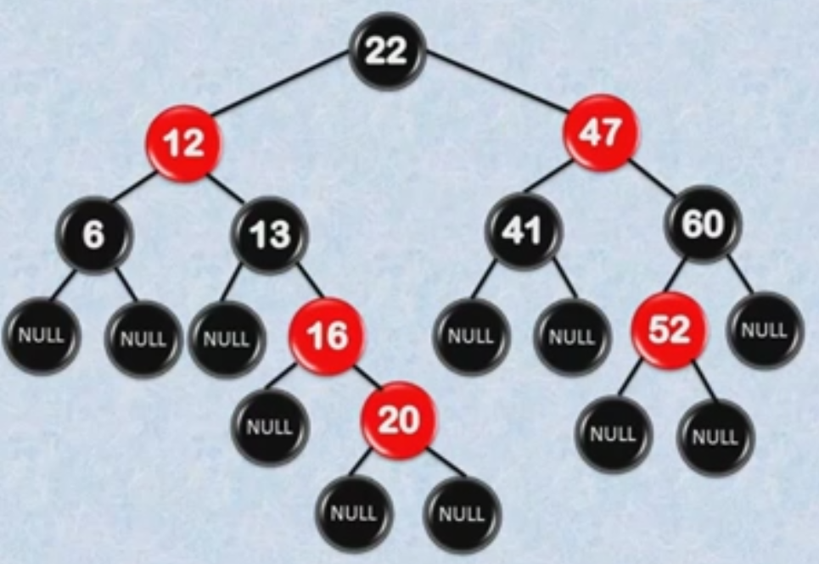
EXERCISE - 16
3rd rule – rotate to right by the grandfather

Slide 28
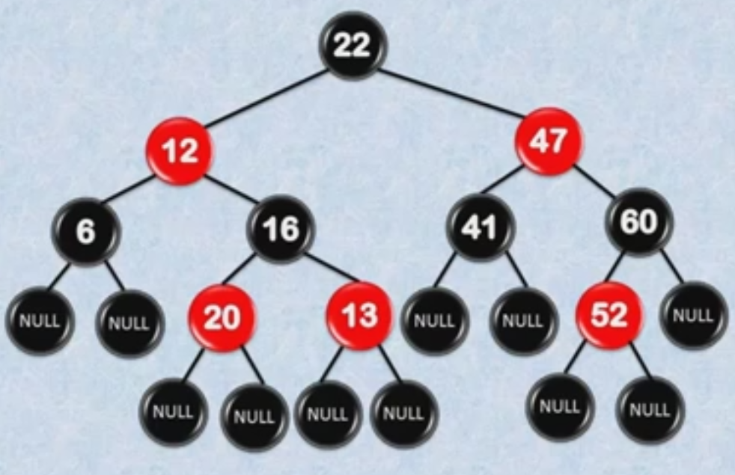
EXERCISE - 16
Fixing…
16
13 20
3rd rule – rotate to right by the grandfather

Slide 29
Use case
Functional programming
Associative arrays
Although often not used in practice.

Slide 30
Persistent dynamic sets
Join operation on red-black trees
AVL trees
Treaps

Slide 31
Avl - tREES
An AVL tree is a binary search tree that is height balanced
Adelson-Velski and Landis, 1962

Slide 32
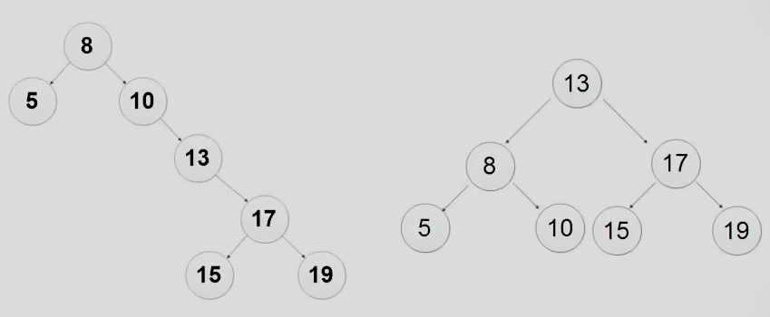
Degenerate tree - Balanced tree

Slide 33
DEMO - insert
BLACK RED TREE AVL : 20,30,40,35,15,50,55,56,57,58

Slide 34
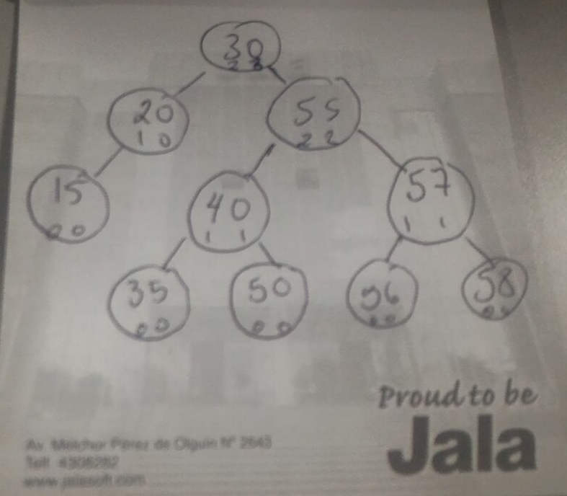
solution

Slide 35
Use case
Functional programming
Associative arrays
Many data structures used in computational geometry can be based on red-black trees.
Although often not used in practice.

